Slide 1
Water Pollution & Treatment Process
1

Slide 2
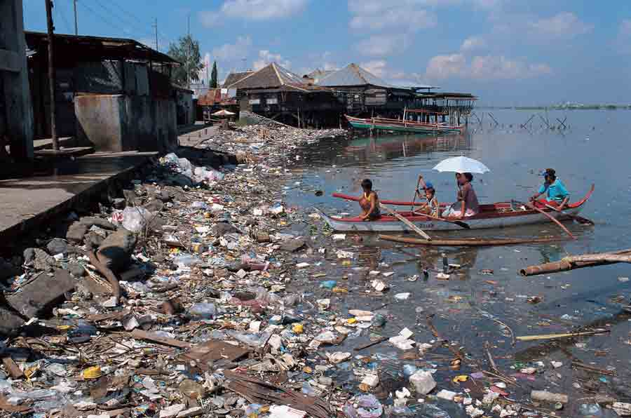
What is Water Pollution?
2
The mixing of undesirable substances in water in an uncontrolled amount beyond the tolerable capacity is Water Pollution.

Slide 3
Why water is polluted?
Domestic Cleanings like Laundry, Food Preparation, Body Cleaning and Body Excretions.
Agricultural Activities like using inorganic fertilizers, Insecticides and Pesticides.
Industrial Processes like Equipment Discharge of the byproducts.
Rain and Flood are the natural processes by which they wash away things like fertilizers, crop fields, river bank, dead body and animals due to turbulency effect, the mixing pollute the water.

Slide 4
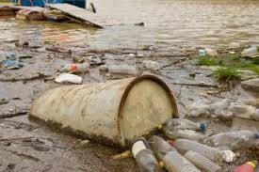
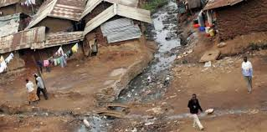
In the World Scenario
About 90 % pollution load in the river system is due to human waste.
At least 2.5 billion people in the developing countries lack an adequate system for disposing of their feces.
About 98% of the people of rural areas use an open field for defecation.

Slide 5
In the Context of Kathmandu
Kathmandu produces 150 tons of waste each day, nearly half of which is dumped into the river.
More than 40 million liters a day of wastewater is generated in Kathmandu
Excessive nitrate, fluoride, and chlorides in the groundwater are three main problems in the Valley’s water. In the Kathmandu valley tanneries and dye, factories are nastiest felonious.
Rivers in the valley, including the Bagmati, Vishnumati, Manohara, and Hanumant are seriously contaminated for this reason. Of the total volume of the flow in the river is 90 percent sewage and the other 10 percent is water.

Slide 6
Sources
Point Source
Located at specific places
Easy to identify, monitor, and regulate
Industrial facilities
Municipal wastewater treatment plants
Non-point Source
Broad, diffuse areas
Difficult to identify and control
Expensive to clean up
Dry weather pollution
Agricultural runoff
Construction debris, etc.
6

Slide 7
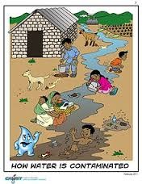
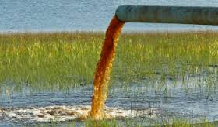
Water Pollutants
Oxygen demanding substances
deplete water of dissolved oxygen
Nutrients ( nitrogen and phosphorus)
Accelerate eutrophication
Residential and agricultural runoff
Municipal waste discharges
Heat
Industrial waste water and Power plants
Other anthropogenic causing temperature rise
Alter water ecology
Lower solubility of oxygen with tempr rise
Increase metabolic rate of organisms
7

Slide 8
Water Pollutants
8
Sediments & suspended solids
Inorganic materials
Land cultivation, constructions, demolitions
Organic solids - deplete water of dissolved oxygen
Municipal Wastewater
High concentration of organic substances, C, N & P
Pesticides, toxic elements, salts & inorganic solids
Agricultural Wastes
N & P
Organic carbon
Pesticides residue
Bacteria

Slide 9
Water Pollutants
9
Petroleum Compounds
Detergents, oils, etc.
Acids & bases
Industries
Radioactive Materials
Pathogens
Bacteria
Viruses
Protozoa
Parasitic Worms

Slide 10
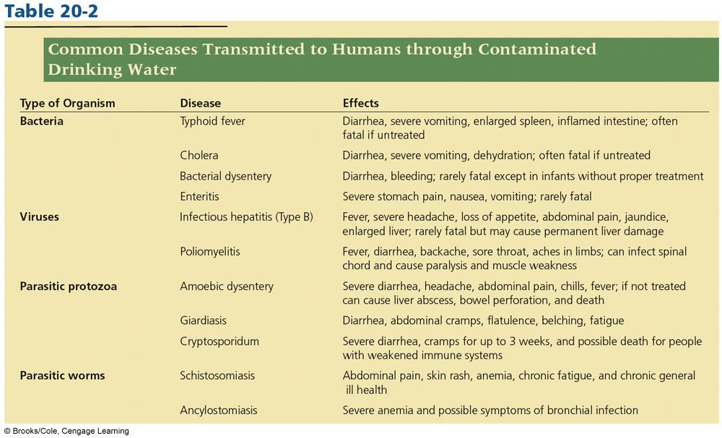
Effect on Humans
10

Slide 11
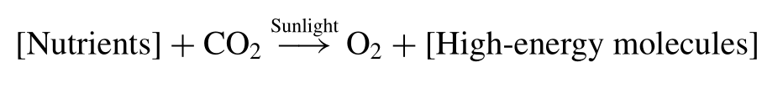
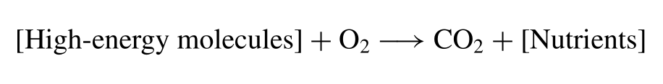
Water Ecology
Producers – Algae, Phytoplankton
Consumers – Zooplankton, Fish & others
Decomposers – Bacteria
Nutrients – N, P, C and S(occasionally)
Photosynthesis
Respiration
11

Slide 12
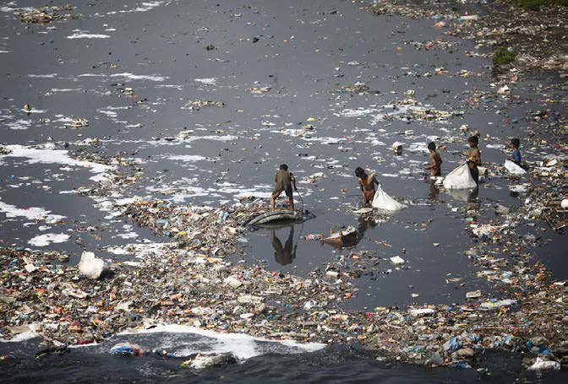
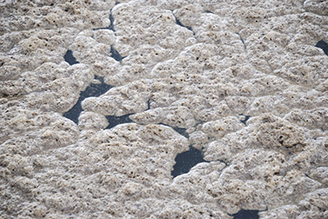
Polluted River
Floating Sludge

Slide 13
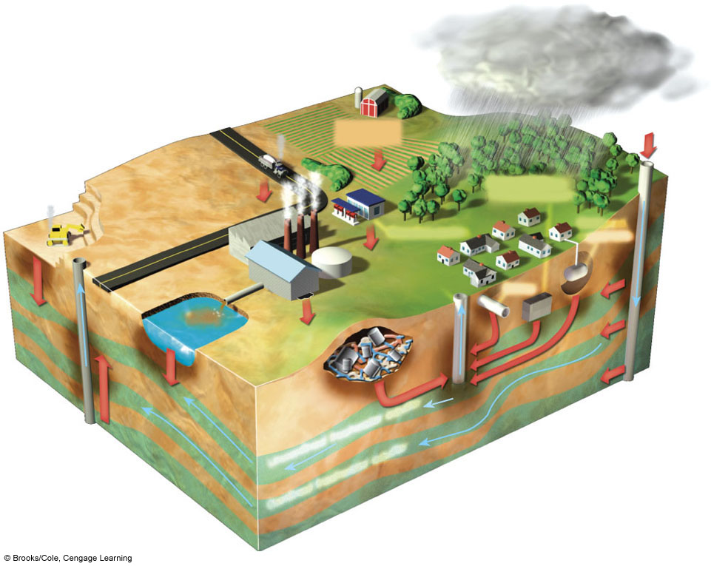
Groundwater Pollution
Polluted air
Hazardous waste injection well
Pesticides and fertilizers
Coal strip mine runoff
Deicing road salt
Buried gasoline and solvent tanks
Gasoline station
Cesspool, septic tank
Pumping well
Water pumping well
Waste lagoon
Sewer
Landfill
Accidental spills
Leakage from faulty casing
Discharge
Confined aquifer
Groundwater flow
Unconfined freshwater aquifer
13
Confined freshwater aquifer

Slide 14
Measures of Water Quality
14
Dissolved Oxygen (DO)
Oxygen Demand – BOD and COD
Nitrogen and Phosphorus
Solids – Suspended and Total
Presence of infections, bacteria and viruses
Turbidity
pH
Heavy metals
Color, taste and odor

Slide 15
Biochemical Oxygen Demand • Rate of oxygen use by microorganisms • Not a measure of some specific pollutant • But measure of the amount of oxygen required by aerobic bacteria to stabilize decomposable organic matter • BOD increases as waste increases • BOD decreases if • Contamination is absent • Microorganisms not present • Available microorganism not interested in consuming
15

Slide 16
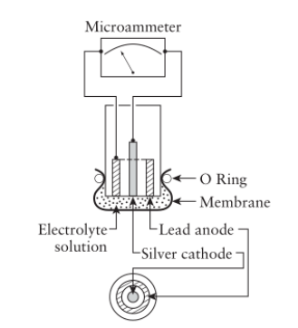
Dissolved Oxygen
• Inversely proportional to
temperature
• maximum amount of
oxygen that can be
dissolved in water at 0 ◦ C
• measured either with an
oxygen probe (galvanic
cell) or by iodometric
titration (Winkers test)
Oxygen Probe

Slide 17
B.O.D.
• Samples taken and put in 60ml or 300ml bottle
• One sample analyzed immediately – measure DO
Specified Time 5 Days
Specified Temperature 20 C
Specified Conditions In the Dark
In the Presence of Bacteria
• Second sealed and stored under:
• After 5 days, amount of DO measure.
• BOD 5 = Initial DO – End DO (mg/L)

Slide 18
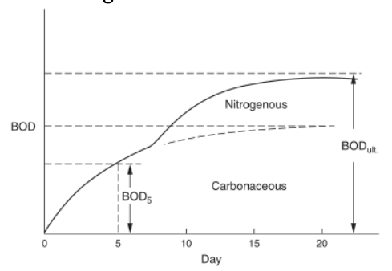
B.O.D
• If instead of stopping test after 5 days and measure DO each
day, we get following curve.
• This discontinuity –due to the demand for oxygen by the microorganisms that decompose nitrogenous organic compounds to inorganic nitrogen

Slide 19
Chemical Oxygen Demand
• BOD test takes 5 days to run – slow
• organic compounds oxidized chemically instead of biologically and shorten the test in COD
• All organic compounds – oxidized
• results always higher than BOD results
• Eg. Wood pulping waste, cellulose are easily
oxidized chemically (high COD) but are very slow to decompose biologically (low BOD).

Slide 20
Turbidity
• Water is not clear but is “dirty,” in the sense that light transmission reduced
• Causes- clays and other tiny inorganic particles, algae, and organic matter
• measured using a turbidimeter
• measure the intensity of scattered light

Slide 21
Nitrogen and Phosphorus
• Nitrogen – organic nitrogen, ammonia, nitrite,
nitrate, and dissolved nitrogen gas
• Phosphorus - organic phosphate and inorganic
orthophosphate

Slide 22
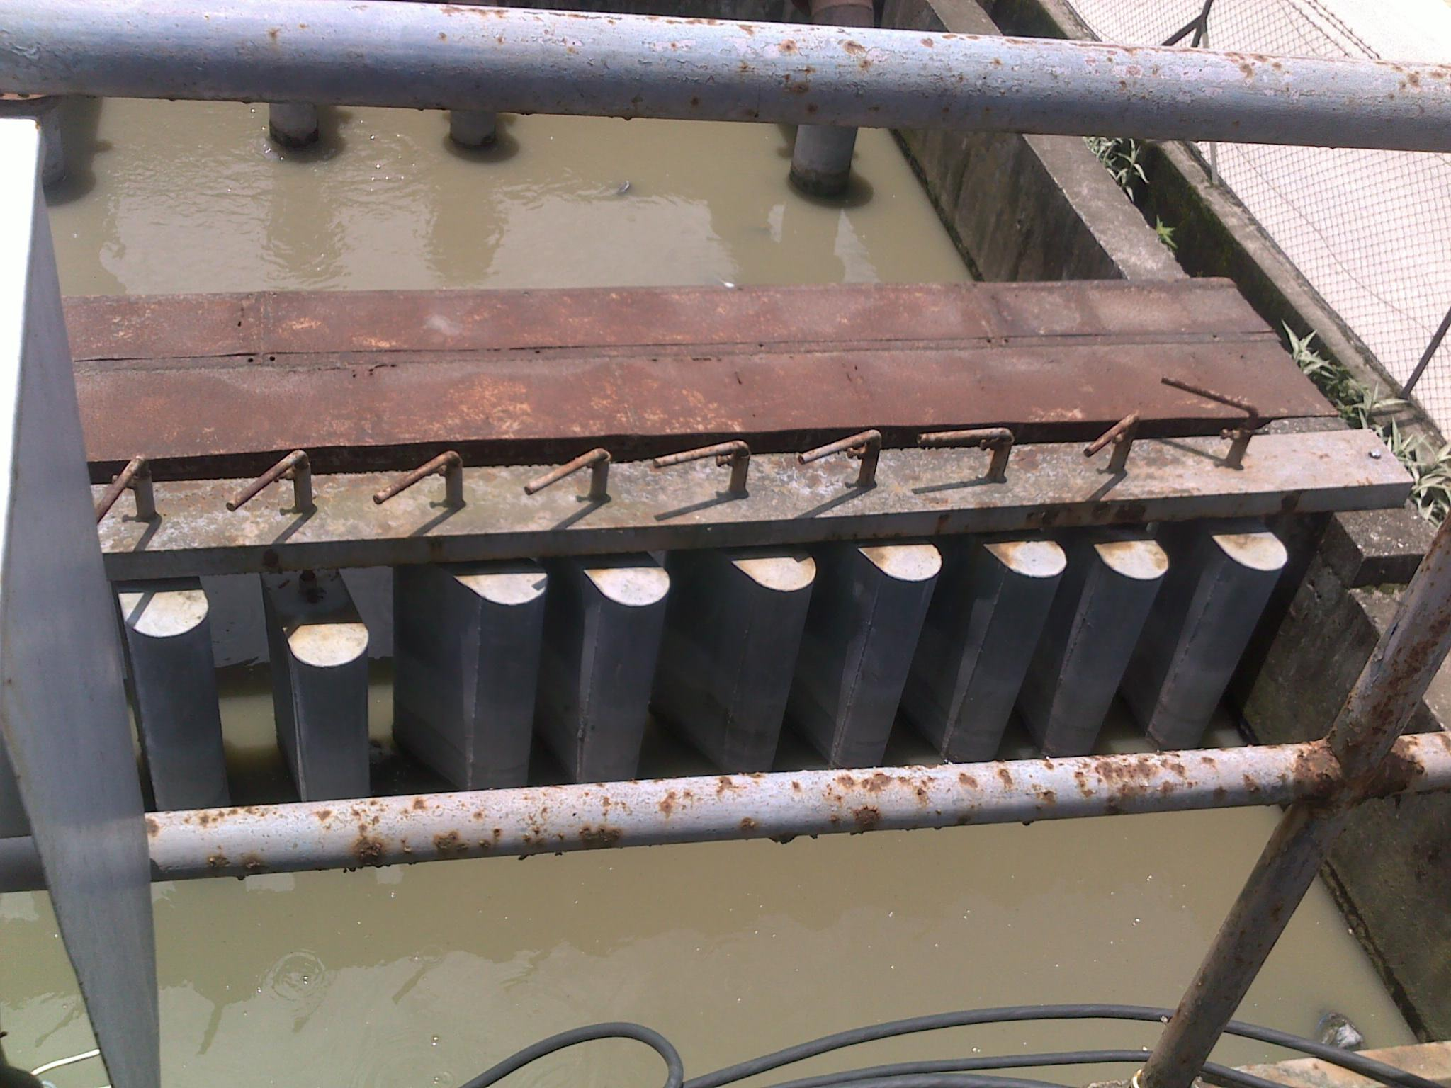
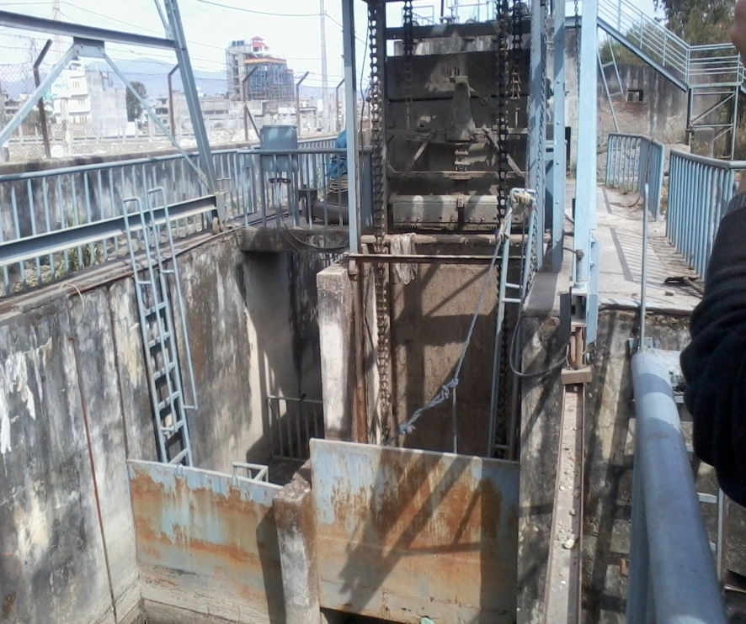
WWT Process
1. Incoming Influent
2. Mechanical Bar Screening
3. Grit Removable Chamber

Slide 23
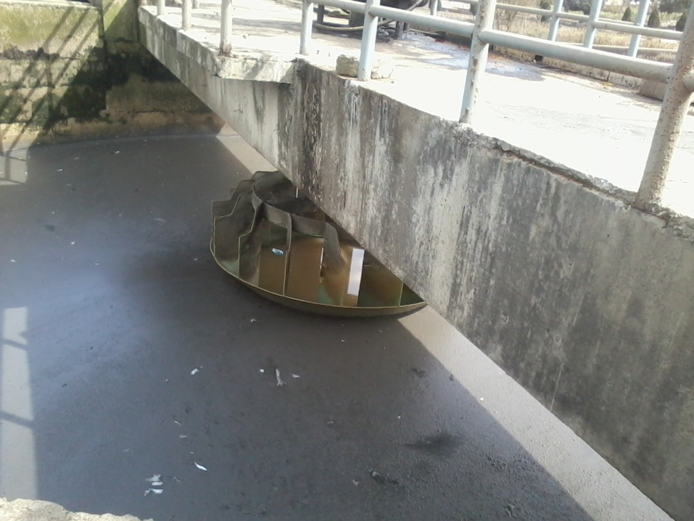
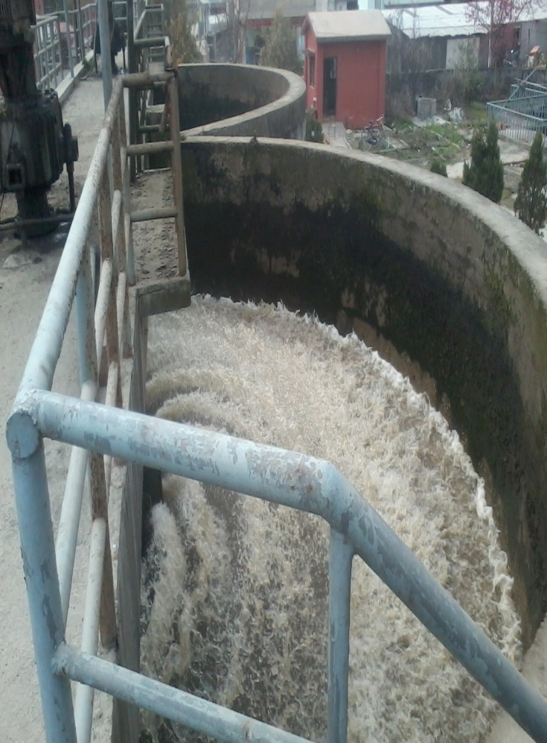
WWT Process
4. Bacterial Mixing
5. Aeration

Slide 24
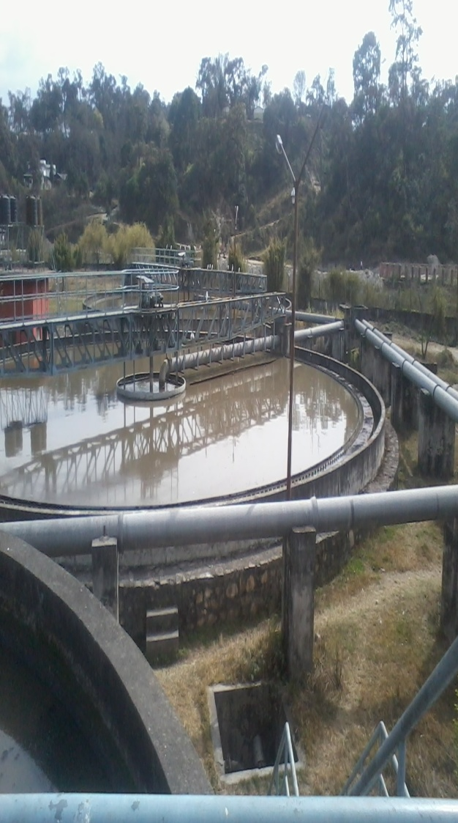
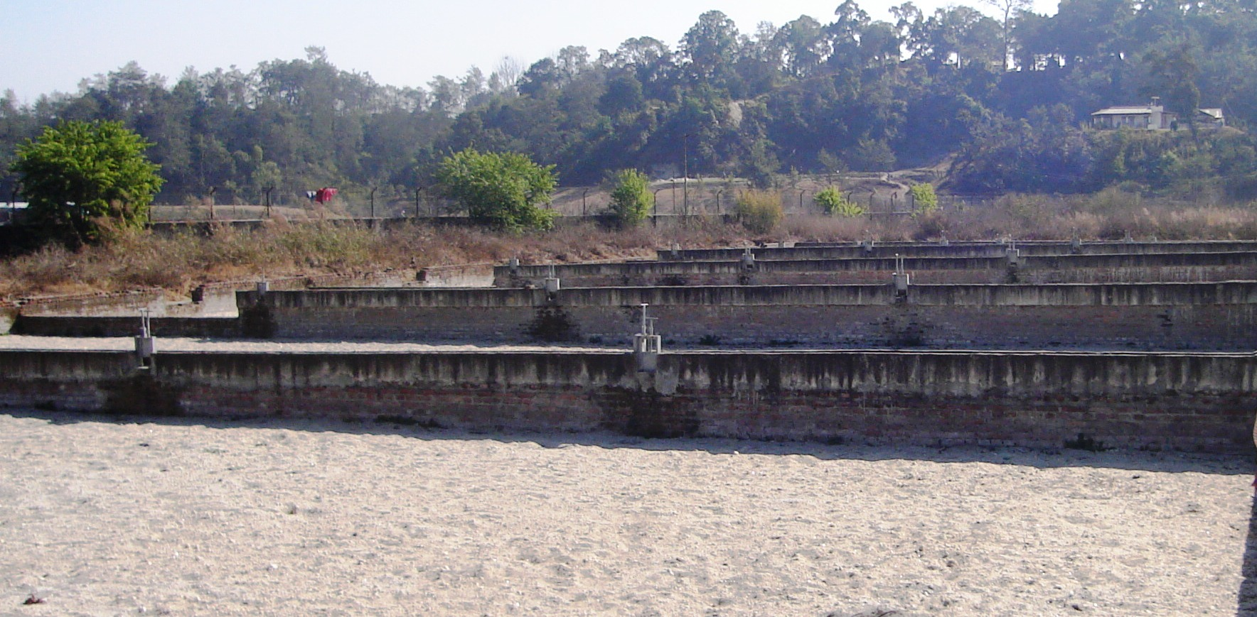
WWT Steps
6. Sedimentation
7. Drying Bed for Sewage

Slide 25
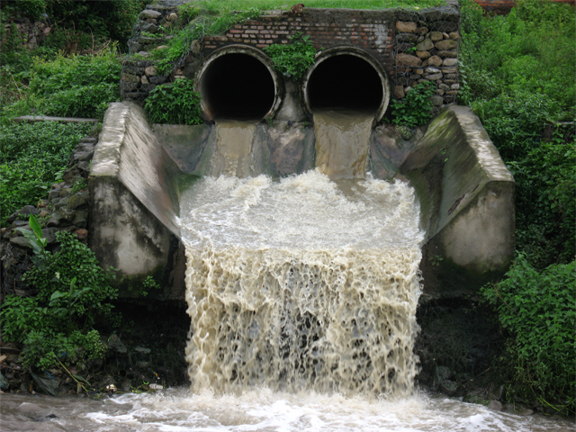
WWT Steps
8. Tunnel Discharge

Slide 26
Water Quality Standards
Quality Parameters Set for Water
National Drinking Water Quality Standard, 2062 (??)
1.Physical Par. Units Concentration Limits
Turbidity NTU 5 (10)
pH 6.5 – 8.5*
Color TCU 5 (15)
Taste, Odor Non-objectionable
TDS mg/L 1000
Elect.Cond. µS/cm 1500

Slide 27
Water Quality Standards
2. Chemical
- Fe, Mn, As, Cd, Cr,
- Cyanide, Fluoride, Pb, NH₃,
- Chloride, Sulphate, Nitrate,
- Cu, Total Hardness, Ca, Zn,
- Hg, Al, Residual Cl
3. Microbiological
- E. Coli, Total Coliform
Other NDWQS Tables
Rural Surface WSS
Rural Ground WSS

Slide 28
Conclusion
Water Pollution as a Major Concern
Best not to Impurify than Cleaning After
Implementation of Proper Plan
Effective and Efficient Treatment Methods

Slide 29
References
Rao, C. (2013). Environmental Pollution Control Engineering. New Delhi: New Age International (p) Limited.
Pandey, S. (2006). Water Pollution and Health, K.U.
Shrestha, K. (2008). Decentralised wastewater management using constructed wetlands in Nepal, Thimee.
Das, A. (2014). Presentation on Water Pollution, I.O.E. Pulchowk.
NDWQS, 2005. Implementation Directives for National Drinking Water Quality Standards, Kathmandu.

Slide 30
THANK YOU!!

